Slide 1
VIRTUAL FAMILY READING EVENT
Kids Read Now In-Home Summer Reading Program

Slide 2

An Introduction to Kids Read Now
Book selection
Discovery sheets
Reporting books
How mailing works
FAQ’s
Notes:
The presentation will discuss book selection, discovery sheets, reporting books, mailings, and frequently asked questions.

Slide 3
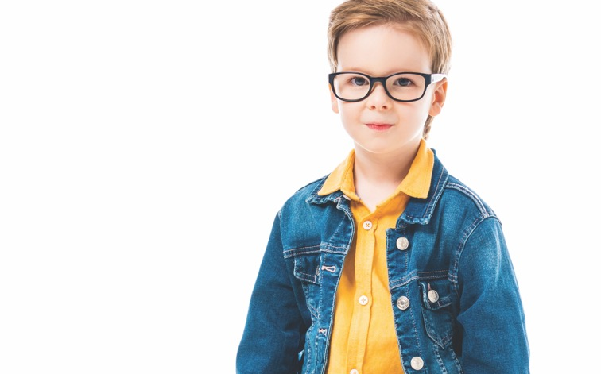
What is Kids Read Now?
9 books
Paid for by the school
FREE to students enrolled in the program
Keep the books forever!
Notes:
Kids Read Now provides your child with 9 books. KRN will mail one writing book and 8 of your child’s self-selected books (or grade specific books) . Most students selected books with their teacher in the spring. The program is no cost to families!

Slide 4



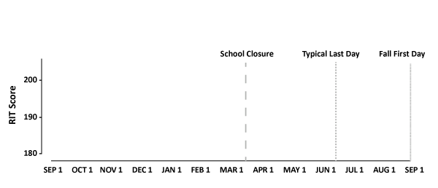

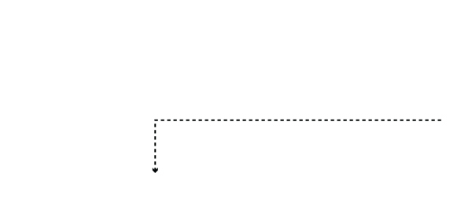
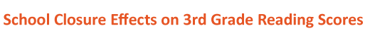
Why Kids Read Now?
Notes:
Students who participate in Kids Read Now show reading score gains compared to those who did not participate.

Slide 5
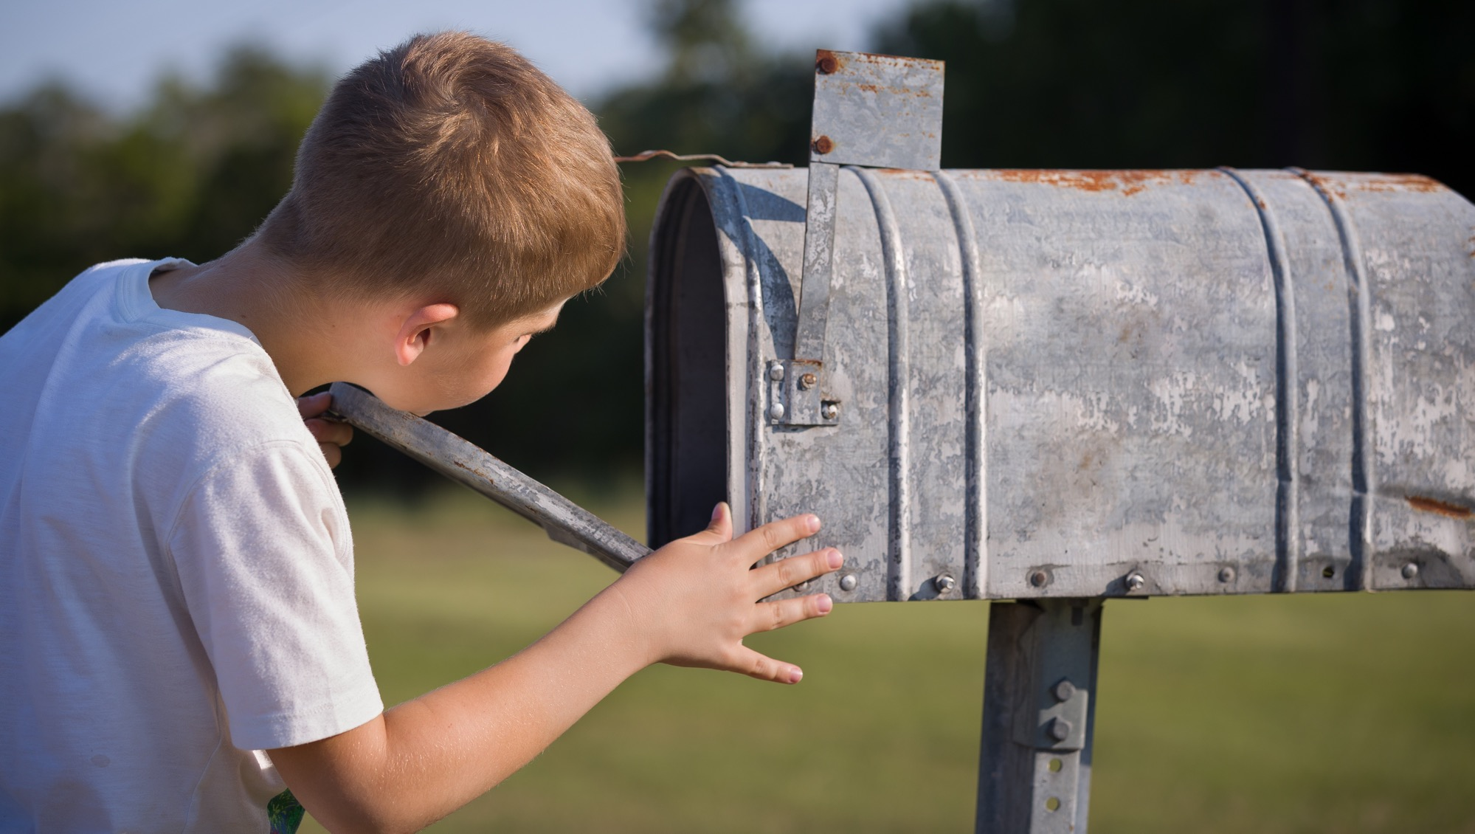
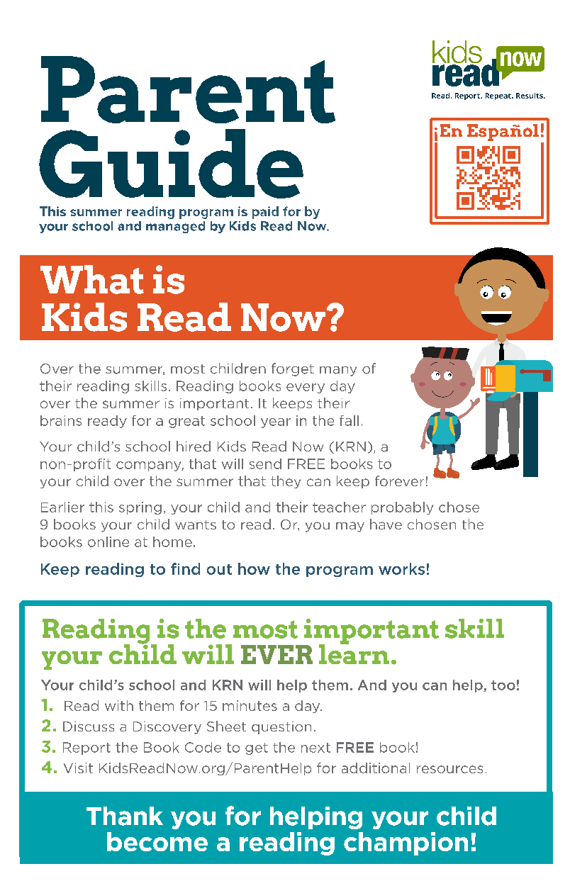

Kids Read Now Books
Notes:
Kids Read Now will mail you a postcard and parent guide prior to books arriving. The parent guide gives all the information you need to know about KRN and their contact information.

Slide 6
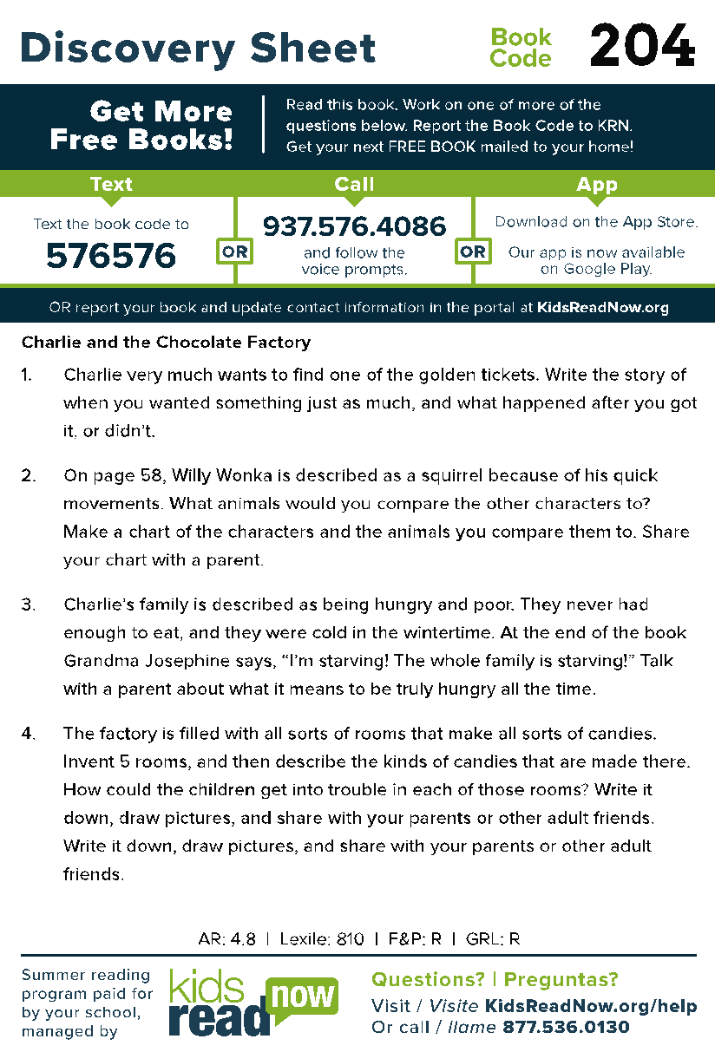
Discovery Sheets
Book Code
Questions
Notes:
Each book has a discover sheet on the front inside cover. There are four discussion questions and a book code with reporting instructions.

Slide 7

How To Report
    CALL 937.576.4086
    TEXT 3-digit book code to 576576 (KRNKRN)
    PARENT PORTAL kidsreadnow.org
    APP
Notes:
Download the KRN app or follow the instructions to report the three-digit book code for each book.

Slide 8
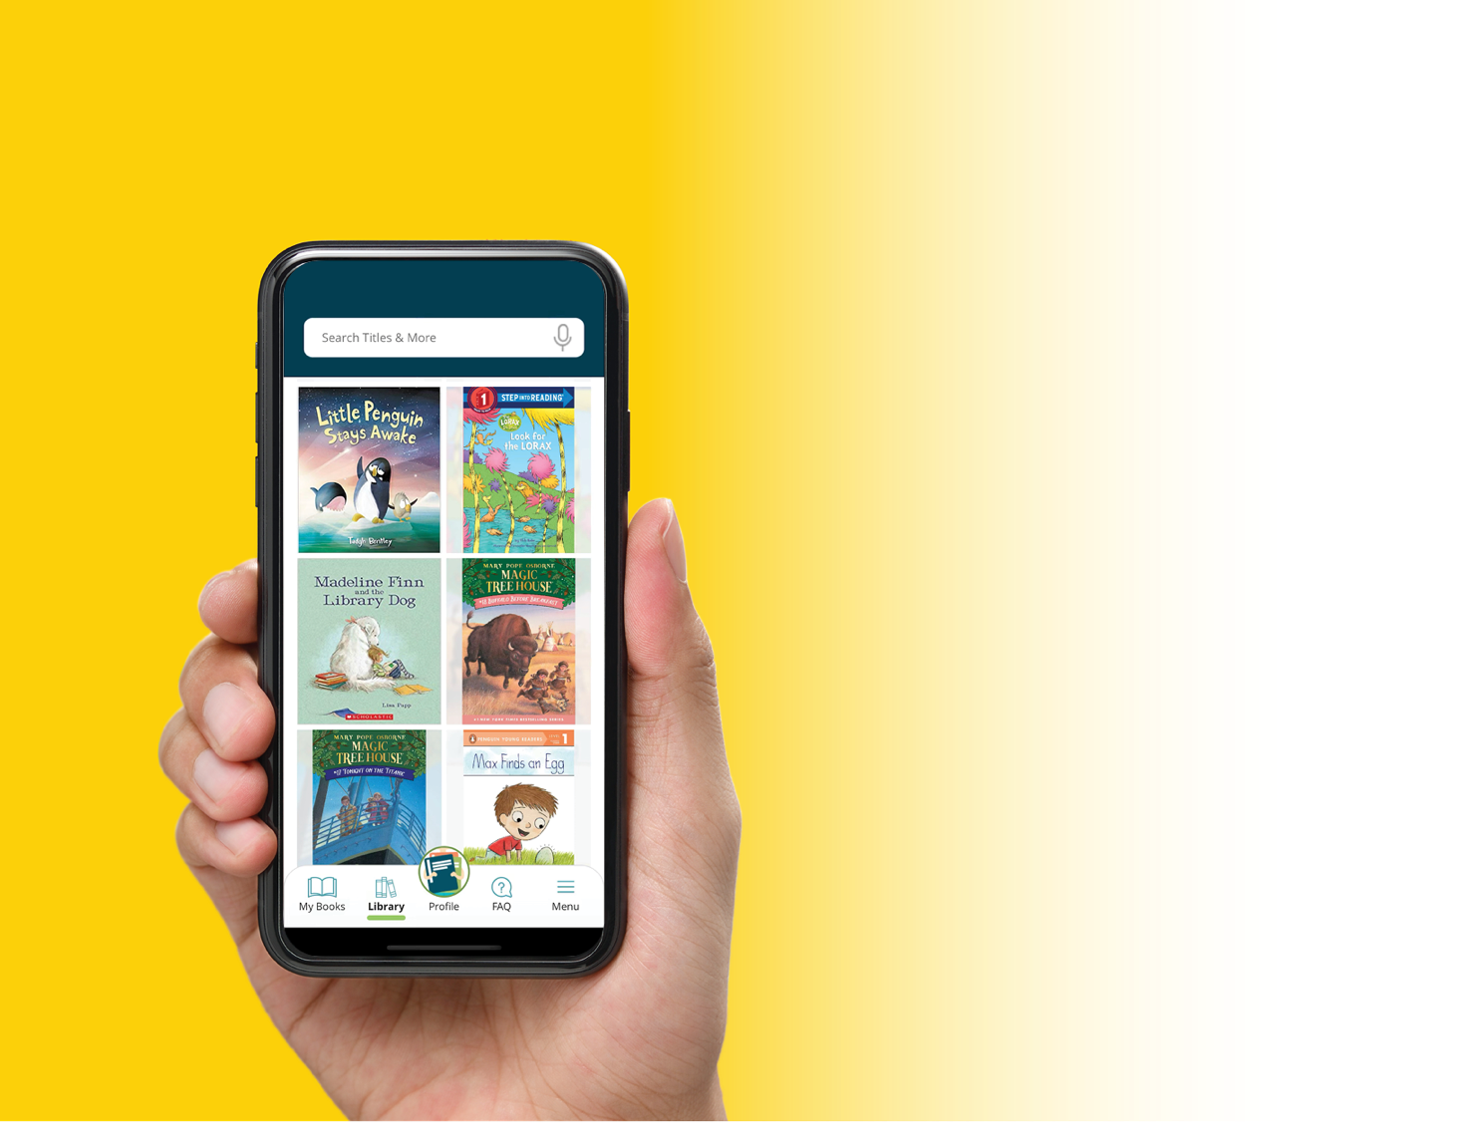
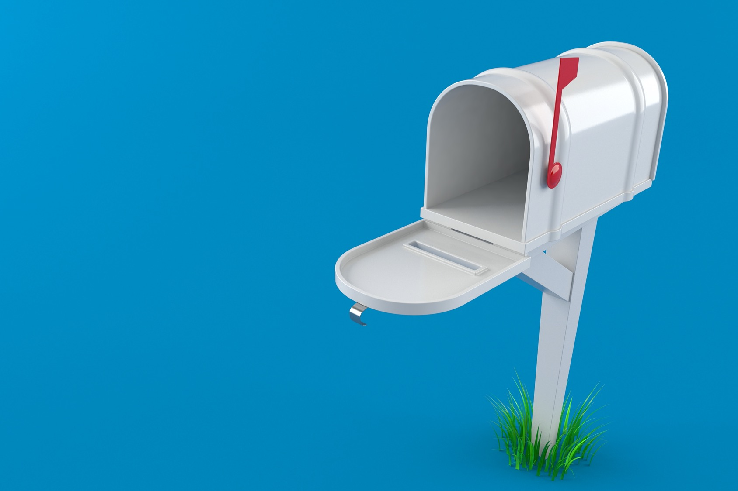

How Mailing Works
Notes:
About one book a week will be automatically mailed to the address KRN has on file.

Slide 9

Read.
Report.
Repeat.
Results.
Notes:
Read a book, report the book, repeat, and see results!

Slide 10


Slide 11
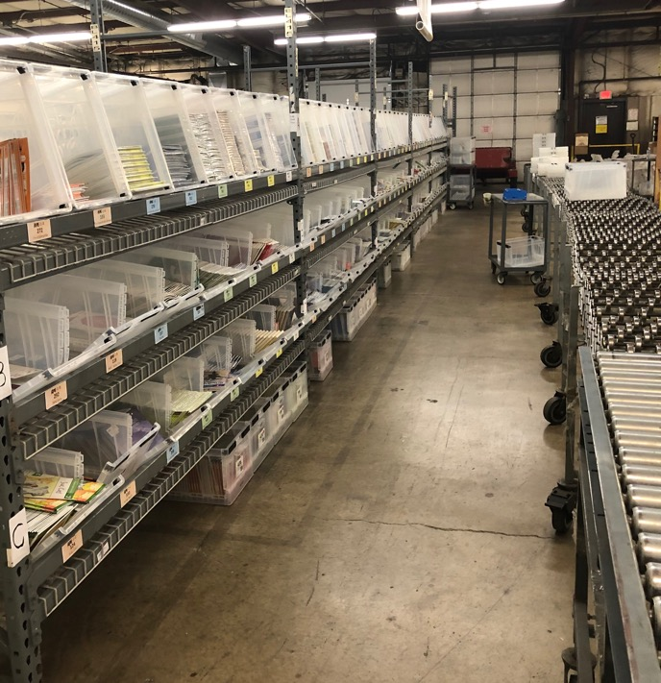
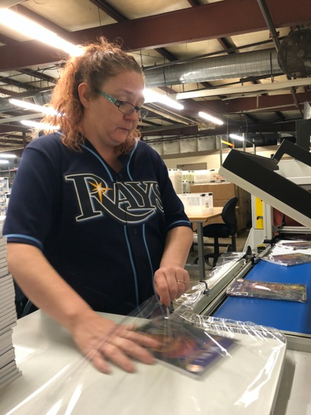
FAQ 1: When Will The Next Book Be Mailed?
Approximately 1 book mailed per week
Books are…
Heat-sealed
Mailed via USPS
In your mailbox within
10-14 business days!
Notes:
Book delivery times varies based on your local USPS locations. They typically take 10-14 business days.

Slide 12
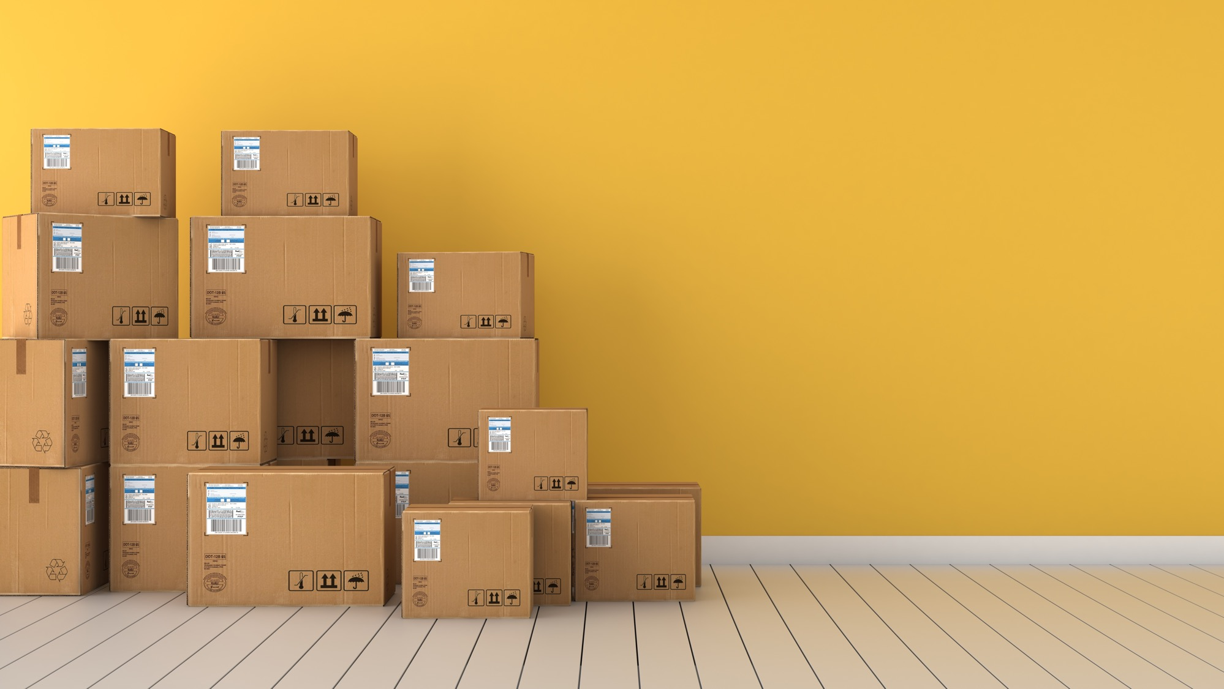
FAQ 2: What if my contact information changes?
CALL 877-536-0130
CHAT kidsreadnow.org
ONLINE portal.kidsreadnow.org
Kids Read Now books are not forwarded
by the post office!
Notes:
Follow the information above or on the parent guide to update your information.

Slide 13

FAQ 3: How many books will my child receive?
Notes:
9 book! 1 writing and 8 reading books will be sent.

Slide 14
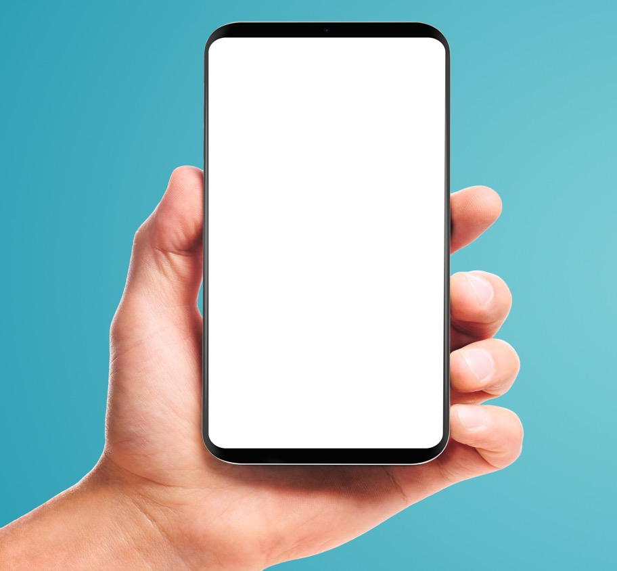
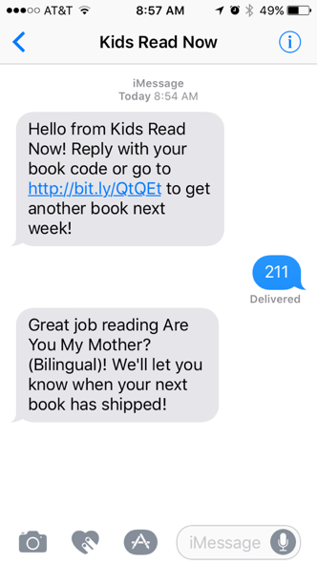
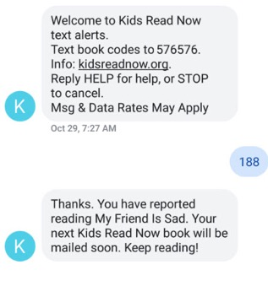
FAQ 4: When can I report book codes?
Notes:
As soon as they are read!

Slide 15


FAQ 5: What happens if my child reports all 8 books?
Confirm reporting in:
Kids Read Now app
Parent portal at KidsReadNow.org
Call Client Success 877-536-0130
Notes:
If 8 books are reported, the student will get a prize and certificate!

Slide 16
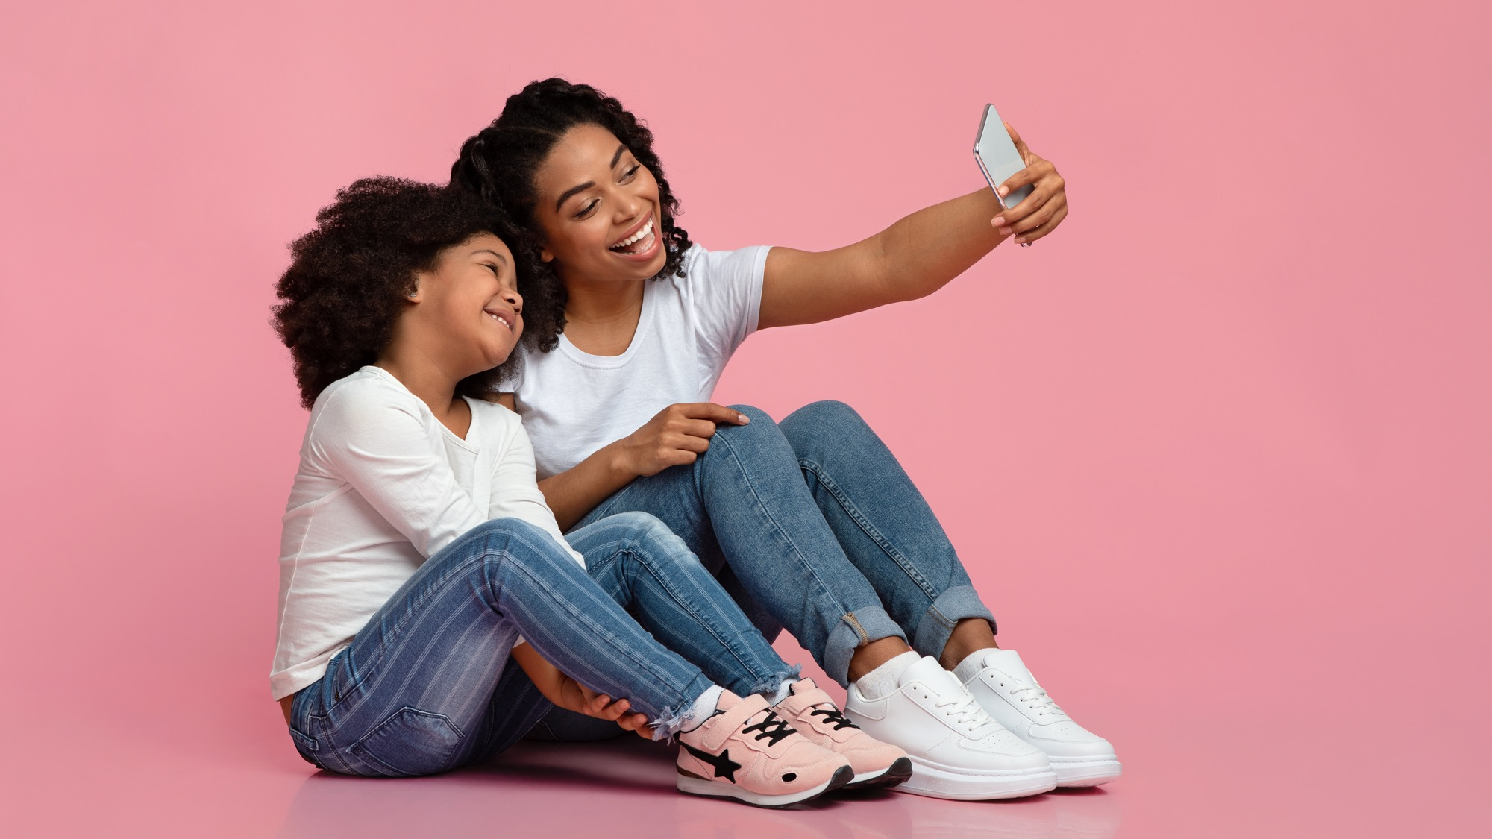

FAQ 6: How can I engage with the Kids Read Now community?
@KidsReadNow
Notes:
Follow us on Instagram, Facebook, and Twitter. Send KRN pictures of your Super Readers!

Slide 17

In Conclusion
CONTACT US:
Client Success
877.536.0130
Chat
KidsReadNow.org
Notes:
Thank you!

